Slide 1


Project Batch: Group 7
HEART DISEASE DATA ANALYSIS USING PYTHON
Presentation on
Under the Guidance
Prof. NAWFAL MD
AUDAZ
PUNITH S : 4AD19ME025
HEMANTH R : 4AD20ME412
RAVI R : 4AD20ME428
BASAVAKIRAN G : 4AD20ME404

Slide 2
CONTENTS 1. INTRODUCTION 2. PROBLEM STATEMENT 3. ALOGORITH & METHODOLOGY 4. WORKING OF THE PROJECT 5. TECHNOLOGIES USED 6. SUMMARY

Slide 3
1.INTRODUCTION
We are going to use various machine learning algorithms to predict the target.
We will be using a number of different features about a person to predict whether they have heart disease or not.
The dependent variable is whether or not a patient has heart disease, while the independent variables are the patient's many medical characteristics.
The various machine learning algorithms used for our model will be Logistic Regression, K-Nearest Neighbours, and Random Forest.

Slide 4
2. PROBLEM STATEMENT
→ Now a Days A major challenge facing in Healthcare organizations(hospitals , medical centers)
Is to provide Quality of services at affordable costs. Quality of Service is mainly depends on correct prediction of doctor .
→ Poor clinical decisions can lead to disastrous consequences which are unacceptable.
→ So to Reduce the cost of clinical tests , organizations need computer based information for prediction of best decision.

Slide 5
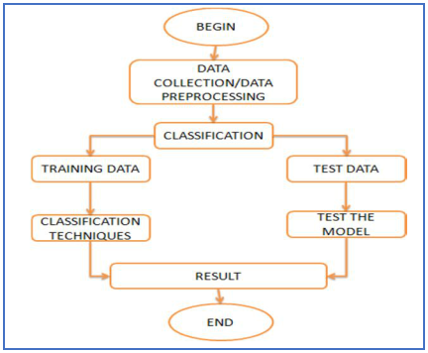
3. ALOGORITH & METHODOLOGY

Slide 6
4. WORKING OF THE PROJECT
We're Going To Take The Following Approach:
1. Data
2. Evaluation
3. Features
4. Modelling
5. Results

Slide 7
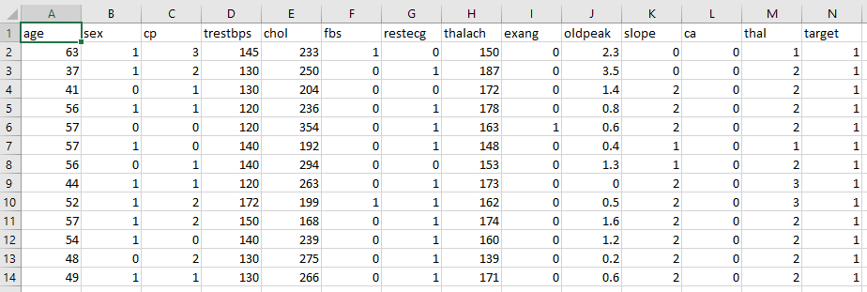
DATASET

Slide 8
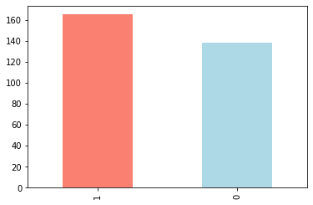
TARGETS FOUND
1 → 165
0 → 138

Slide 9
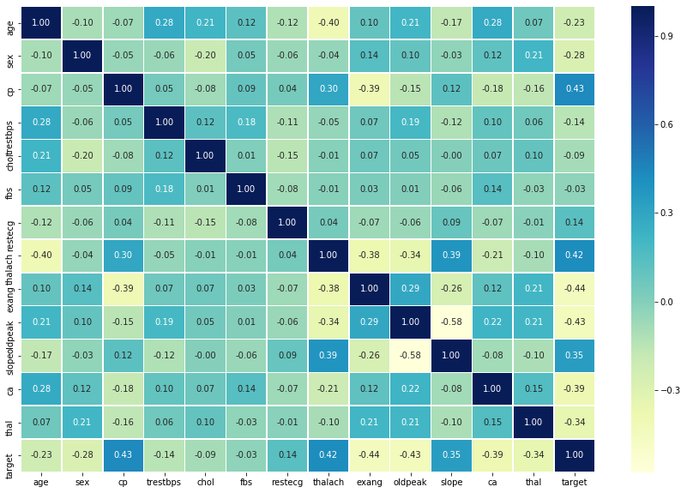
CORRELATION PLOT

Slide 10
3 STEP PROCESS
Split the dataset
Train the dataset
Compare Algorithms

Slide 11
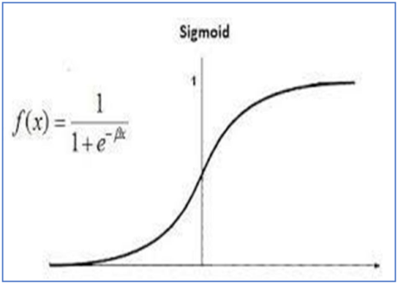
MACHINE LEARNING MODELS
Logistic Regression :
It is a basic classification algorithm which predicts the probability of a target variable.

Slide 12
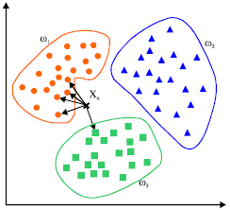
K-Nearest Neighbours :
It's a machine learning algorithm that's supervised.
The idea behind nearest neighbour methods is to find a predetermined number of training samples that are closest in distance to the new point and use them to predict the mark.
It makes no assumptions about the data and is typically used for classification tasks where little to no prior knowledge of the data distribution is available.
Finding the k closest data points in the training set to the data point for which a target value is unavailable and assigning the average value of the identified data points to it is the aim of this algorithm.

Slide 13

Random Forest :
Random forest is a supervised machine learning algorithm that can be used to solve problems in both classification and regression.
It builds decision trees out of data samples, then gets predictions from each of them before voting on the best solution

Slide 14
RESULTS OBTAINED BY MACHINE LEARNING MODELS
LOGISTIC REGRESSION → 0.8852459016393442
KNN → 0.6885245901639344
RANDOM FOREST → 0.8360655737704918

Slide 15
COMPARE WITH MODELS AND ACCURACIES

Slide 16
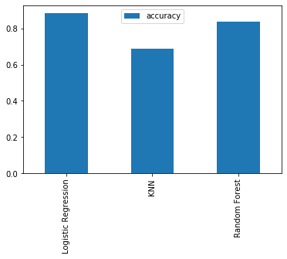
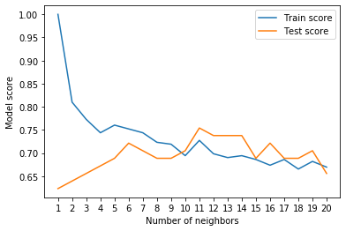

Slide 17
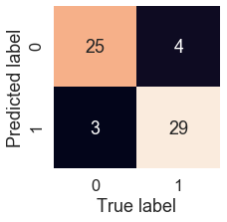
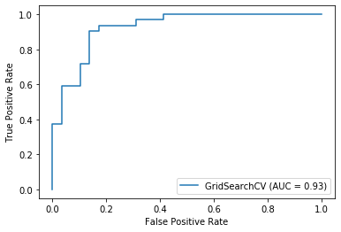

Slide 18
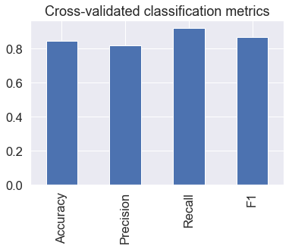
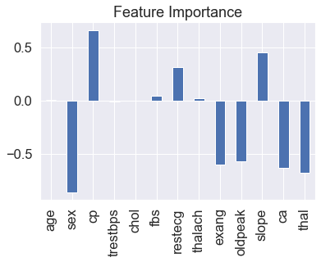

Slide 19

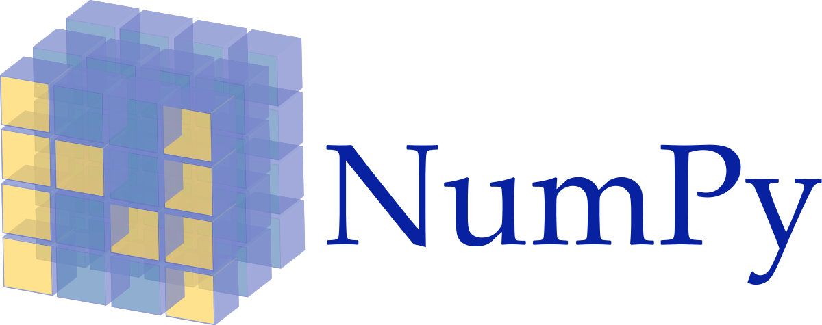

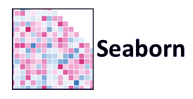

5. TECHNOLOGIES USED

Slide 20
6. SUMMARY
With the rising number of deaths due to heart disease, it is becoming increasingly important to build a system that can effectively and accurately forecast heart disease.
The motivation for the study was to find the most efficient ML algorithm for detection of heart diseases.
This compares the accuracy score of KNN, Logistic Regression and Random Forest for predicting heart disease using UCI machine learning repository dataset.
The result of this study indicates that the Logistic regression algorithm is the most efficient algorithm with accuracy score of 89% for prediction of heart disease.
Accuracy of the algorithms in machine learning depends upon the dataset that used for training and testing purpose.

Slide 21


